Slide 1

Language & Literacy
Volume II
"Reading should not be presented to children as a chore or duty. It should be offered to them as a precious gift."
— Kate DiCamillo
EDUC 3103 – Final Project
Joleen Binder
November 8, 2021

Slide 2

Table of Contents
2
3
Foundational Knowledge in Reading and Writing _________
7
Curriculum and Instruction___________________________
Assessment and Evaluation___________________________
11
Diversity and Equity_________________________________
13
Learners and the Literacy Environment_________________
16

Slide 3
Foundational Knowledge in Reading and Writing
3
Fundamentals of Phonemic awareness/phonics
Reading Rockets:
Find resources for print awareness, phonological and phonemic awareness, phonics and decoding, fluency, vocabulary, spelling, comprehension, writing, informal assessment, etc.
http://www.readingrockets.org/teaching/reading-basics
http://www.readingrockets.org/teaching/reading-basics/phonemic
Phonemes:
A comprehensive list of the 44 phonemes found in the English language and examples of variations in their spelling. Student awareness of these phonemes can make spelling easier. Also see Secret Stories below.
http://www.dyslexia-reading-well.com/support-files/the-44-phonemes-of-english.pdf
Balanced Literacy Diet Website:
Phonemic awareness is the ability to understand that the sounds of spoken language work together to make words. Find resources for teaching and assessing phonemic awareness here.
https://www.oise.utoronto.ca/balancedliteracydiet/Phonemic_Awareness.html
Sight Word list:
Lists Dolch word lists by grade. Includes lessons, flashcards, and games.
http://www.sightwords.com/sight-words/dolch/

Slide 4
Foundational Knowledge in Reading and Writing
4
Phonemic Awareness/Phonics resource
Secret Stories:
Katie Garner brings a new way for students to decode the English language with exciting stories that are easy for students to remember.
https://www.youtube.com/watch?v=f2LEpxXhHHE
Secret Stories Scripts:
https://docs.google.com/document/d/1uN7HG3xy2h0iF82KR4lIoYKQb7PhPujO/edit?usp=sharing&ouid=107888366066094725107&rtpof=true&sd=true
The Better Alphabet Song:
Based on the more commonly used alphabet sounds.
https://www.youtube.com/watch?v=f2LEpxXhHHE
The Science of Reading:
The research of the reading experts and comparing balanced literacy and phonics strategies.
https://www.scilearn.com/the-science-of-reading-the-basics-and-beyond/
Writing Pedagogy
Writer’s Workshop example used in a Kindergarten classroom.
The teacher uses modelling of how to sound out words, use brave writing, use dialogue in a story, and so much more.
https://www.youtube.com/watch?v=uI2LBpCwyOE
Cult of Pedagogy Podcast #101:
A step-by-step plan for teaching narrative writing that includes examples for student choice in writing.
https://www.cultofpedagogy.com/narrative-writing/
ARPDC Writing Guide:
Practical (and amazing) ideas on how to encourage students to write through mini-lessons, independent writing, guided writing, conferencing, and sharing/author’s chair.
https://arpdcresources.ca/wp-content/uploads/2017/03/Writing-20Mar17.pdf

Slide 5
Foundational Knowledge in Reading and Writing
5
Foundations of Writing
Balanced Literacy:
An overview of writing processes and strategies, including teaching, assessing, and other resources. https://www.oise.utoronto.ca/balancedliteracydiet/Writing_Processes_Strategies.html
First Steps Writing Resource Book (download):
Explicit teaching of writing through instructional procedures, different forms of writing, conventions, and processes and strategies.
http://det.wa.edu.au/stepsresources/detcms/navigation/first-steps-literacy/
Writing Programs
6+1 Traits of Writing:
Kristina Smekens introduces her 6 traits; ideas, organization, voice, word choice, sentence fluency, and conventions. The +1 is presentation. Tons of resources and lesson ideas here.
https://www.smekenseducation.com/6-traits-of-writing/
The Daily Five:
1. Read to self 2. Work on writing 3. Read to someone 4. Word work 5. Listen to reading. Resources available to launch this writing program in your classroom.
https://www.thedailycafe.com/daily-5
Units of Study:
Lucy Calkins. A balanced approach to literacy to support explicit instruction in writing for elementary students.
https://www.unitsofstudy.com/k5writing/
Writing Essentials:
Regie Routman. Tons of resources available to help simplify writing instruction in the elementary classroom.
https://www.regieroutman.org/

Slide 6
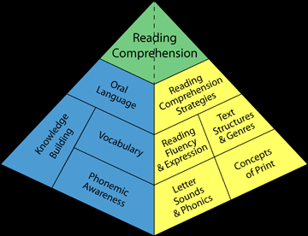
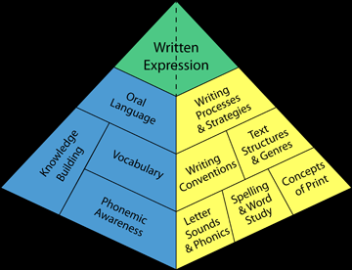
Foundational Knowledge in Reading and Writing
6
Reading Pyramid
Writing Pyramid

Slide 7
Curriculum and Instruction
7
Essential Alberta Government Websites for ELA Instruction
Alberta Program of Studies for English Language Arts:
https://education.alberta.ca/media/160360/ela-pos-k-9.pdf
Learn Alberta - Grade by grade objectives:
http://www.learnalberta.ca/ProgramOfStudy.aspx?lang=en&ProgramId=404703#
Alberta Education Competencies:
https://education.alberta.ca/media/3272998/competency-indicators-september-30-2016.pdf
Alberta Government Literacy and Numeracy Progressions:
https://education.alberta.ca/media/3402192/lit-and-num-progressions.pdf
Suggestions to Consider When Building ELA Lesson Plans
ELA Illustrated Examples K-3:
https://open.alberta.ca/dataset/afa5f4ce-5de8-4898-bed6-134f447a7bcc/resource/10104711-b344-4fe2-8ea1-53d944643c1d/download/2000-english-language-arts-illustrative-examples-kindergarden-grade-3.pdf
ELA Illustrated Examples Gr 4:
https://education.alberta.ca/media/160426/ela-illustrative-examples-grade-4.pdf
ELA Illustrated Examples Gr 5:
https://education.alberta.ca/media/160421/ela-illustrative-examples-grade-5.pdf
ELA Illustrated Examples Gr 6:
https://education.alberta.ca/media/160425/ela-illustrative-examples-grade-6.pdf
What to include in a language arts lesson:
https://www.oise.utoronto.ca/balancedliteracydiet/Food_Groups/index.html

Slide 8
Curriculum and Instruction
8
Spark Creativity (Betsy Potash)
Creative vocabulary:
There are many ways to teach vocabulary creatively. In this article, Betsy Potash mentions video journals, meaningful vocabulary products, postcards, posters, one-pagers, games, tattoo designs, post-it stations, makerspace, and magic spells.
http://www.nowsparkcreativity.com/2019/06/067-10-creative-ways-to-teach-vocabulary.html
The Power of Imperfect Action:
Take chances in teaching, don’t wait for the “perfect” time. Mistakes might pay off in the end.
http://www.nowsparkcreativity.com/2018/10/050-power-of-imperfect-action.html
Penny Kittle:
Vetted resources and advice for how to teach creatively and allow students voice and choice in their education.
https://pennykittle.net/
Balanced Literacy Diet
The Balanced Literacy Diet offers a plethora of resources for helping your students develop literacy.
https://www.oise.utoronto.ca/balancedliteracydiet/Recipe/00056/
https://www.oise.utoronto.ca/balancedliteracydiet/Vocabulary.html
How to teach reading debate:
https://www.nytimes.com/2020/02/15/us/reading-phonics.html
Rebuttal:
http://www.danielwillingham.com/daniel-willingham-science-and-education-blog/the-current-controversy-about-teaching-reading-comments-for-those-left-with-questions-after-reading-the-new-york-times-article?utm_source=feedburner&utm_medium=email&utm_campaign=Feed%3A+nbspDanielWillingham-DanielWillinghamScienceAndEducationBlog+%28Daniel+Willingham%27s+Science+and+Education+Blog%29

Slide 9
Curriculum and Instruction
9
Modelled, Shared, Guided, and Independent Reading
Resources for implementing literacy in the classroom using a variety of strategies.
First Steps Reading Resource Book (download):
http://det.wa.edu.au/stepsresources/detcms/navigation/first-steps-literacy/
Marie Clay - Reading Recovery program:
https://irrto.org/about-reading-recovery/
Louisa Moats - Teaching Reading is Rocket Science:
https://www.aft.org/sites/default/files/reading_rocketscience_2004.pdf
Fountas & Pinnell:
https://www.fountasandpinnell.com/textlevelgradient/
Richard Allington:
https://www.ocmboces.org/tfiles/folder1237/1603_Allington_WRM.RT_.pdf
Lucy Calkins:
http://www.unitsofstudy.com/introduction
First Steps Reading Resource Book (download):
Comprehension strategies
http://det.wa.edu.au/stepsresources/detcms/navigation/first-steps-literacy/
Jolly Phonics (Gr 2)
http://jollyreading.com/introduction-to-jolly-phonics/
Fun Time Phonics (Gr 3)
https://www.criticalthinking.com/fun-time-phonics.html
Literacy Place (Gr 4)
https://education.scholastic.ca/category/LITERACY-PLACE-FOR-THE-EARLY-YEARS
Joyful Literacy (Gr 5 & 6)
https://www.joyfulliteracyonline.com/about-joyful-literacy
Secret Stories
https://www.thesecretstories.com/

Slide 10
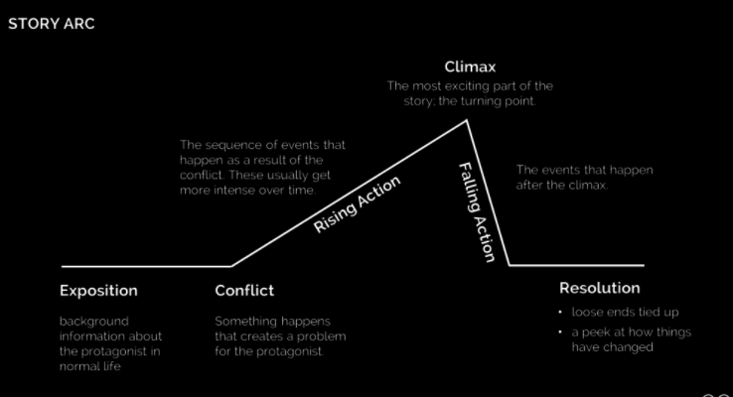
Curriculum and Instruction
10
Classroom Resources for Creating a Musical
Melody:
https://www.youtube.com/watch?v=OQBYMsi5yBM
https://theproducerkit.com/blogs/news/how-to-write-the-best-melodies
https://www.edmprod.com/memorable-music/
Writing story/script:
http://www.musicals101.com/book.htm
http://www.musicals101.com/write.htm
Choreography:
https://www.mtishows.com/marketplace/resource/pre-performance/the-original-production-choreography-videos
http://www.danceadvantage.net/choreography-community-theatre/
Classroom Resources for Storytelling
The Moth
https://themoth.org/

Slide 11
Assessment and Evaluation
11
Creating a Rubric:
Generate rubrics (all subjects).
http://rubistar.4teachers.org/index.php
Fountas & Pinnell Levels:
https://www.fountasandpinnell.com/textlevelgradient/
General Assessment Strategies:
Natalie Regier. Tools on how and when to use formative assessment.
https://www.livebinders.com/play/play?id=574194
Assessment (peruse documents):
Formative assessment strategies.
https://portal.gssd.ca/public/mr3xg4k4nrxxq5dvfz4hq5lomq/Lists/SharedDocuments/Assessment/Formative%20Assessment%20Ideas-Natalie%20Regier.pdf
Preassessment Strategies.
https://tfelatnps.edublogs.org/files/2018/03/Pre-assessment-Strategies-19fbz59-1k7ad85.pdf
Grammar rules every teacher should know:
https://www.google.ca/search?q=grammatical+rules+every+teacher+should+know&rlz=1C1GGRV_enCA751CA751&oq=grammatical+rules+every+teacher+should+know&aqs=chrome..69i57.10031j0j7&sourceid=chrome&ie=UTF-8

Slide 12
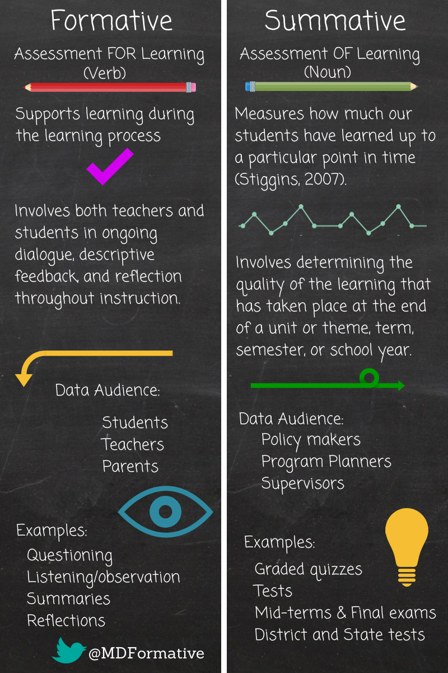
Assessment and Evaluation
12

Slide 13
Diversity and Equity
13
Differentiation
AB Education Differentiation document – Making a difference: meeting diverse learning needs with differentiated instruction.
https://education.alberta.ca/media/384968/makingadifference_2010.pdf
http://www.readingrockets.org/article/what-makes-differentiated-instruction-successful
How to differentiate:
http://www.readingrockets.org/article/what-differentiated-instruction
http://www.readingrockets.org/reading-topics/differentiated-instruction
What does differentiation look like in a classroom?
http://www.readingrockets.org/article/differentiated-classroom-structures-literacy-instruction
Why some kids struggle:
https://www.readingrockets.org/helping/struggle

Slide 14
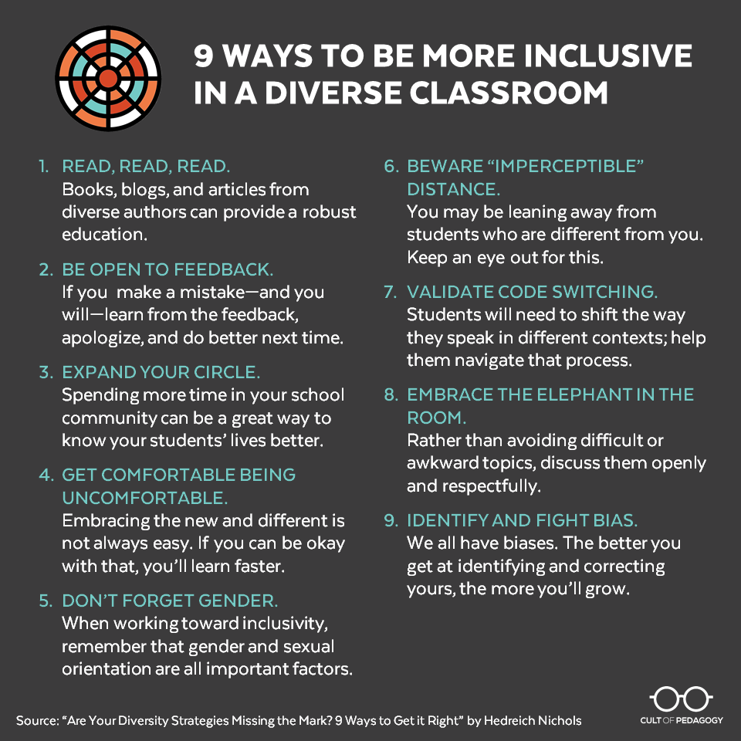
Diversity and Equity
14
Multicultural Education
ATA:
Information for human rights, inclusion, Indigenous education, sexual orientation and gender identity, working with immigrant students and families, and faith communities.
https://www.teachers.ab.ca/For%20Members/Professional%20Development/Diversity-Equity-and-Human-Rights/Resources/Pages/Resources.aspx
Cult of Pedagogy – Why White students need multicultural and social justice education:
Multicultural education can help white students connect to their own culture. Inclusive education is important for all students!
https://www.cultofpedagogy.com/white-students-multicultural-ed/

Slide 15
Diversity and Equity
15
ELL Support Resources
10 Key Policies and Practices:
Researched-based strategies for working with ELL students.
www.meadowscenter.org/files/resources/10Key_ELLs_Web_Rev.pdf
ELL Support Resources for Teachers:
Benchmarks for reading and reading assessment.
http://www.learnalberta.ca/content/eslapb/search_about.html
Writing Samples by Grade and Level:
https://www.learnalberta.ca/content/eslapb/writing_samples.html
Alberta Education ESL Guide to Implementation :
K-9 guide to teaching ELA to ELL students.
https://education.alberta.ca/media/563809/esl-guide-to-implementation-k-9.pdf
Books for more information:
Fifty strategies for teaching English language learners (2008) PE 1128 A2 H467
Teaching English language learners 428.07 Wal
Teaching ELL K-12: a quick-start guide for the new teacher (2004) PE 1128 A2 J47
English language learners (2009) PE 1068 U5 E53
FNMI Resources
FNMI: Survivors Speak:
Survivors of residential schools speak about their experiences.
http://orcabook.com/speakingourtruth/honesty.html
Indigenous Storytelling Resource:
Under the heading “Oral Traditions” find recordings of Indigenous stories and other resources.
https://uat.learnalberta.ca/content/aswt/

Slide 16
Learners and the Literacy Environment
16
Choosing Great Books for Your Classroom
Teacher First Top 100 Books:
Listed by age category.
http://www.teachersfirst.com/100books.cfm
Caldecott Winners
https://abqlibrary.org/c.php?g=19174&p=108386
NCTE Anti Racist books (National Council for Teacher Education)
https://ncte.org/blog/2020/06/antiracist-books-curriculum-today/
Comprehensive listings for character building books:
http://www.the-best-childrens-books.org/Character-Education-books.html
http://www.goodnet.org/articles/25-childrens-books-that-teach-kids-meaningful-values
ILA Teachers’ Choice Award”
https://www.literacyworldwide.org/get-resources/reading-lists/teachers-choices-reading-list
Interesting levelled readers
https://www.orcabook.com/reading-levels.aspx
Project-Based Lesson Creation
Creating project-based lessons:
How to brainstorm authentic project ideas, plan with the end in mind, benchmark your project, build rubrics, plan for assessments, and much more.
https://www.cultofpedagogy.com/project-based-learning-lesson/
University of Toronto – Creative Collaborative Curriculum Ideas:
Resource for cross-curricular, thematic units.
https://tspace.library.utoronto.ca/bitstream/1807/93059/1/ccca_v2_nowplay2018_digital.pdf

Slide 17
Learners and the Literacy Environment
17
Maverick Units/Lessons
Bringing creativity into lessons to engage students in literacy.
Creative Collaborative Curriculum Activities (K-2):
https://tspace.library.utoronto.ca/bitstream/1807/93059/1/ccca_v2_nowplay2018_digital.pdf
Puppetry
https://www.edutopia.org/blog/puppets-will-change-your-classroom-sam-patterson-cheryl-morris
Makerspace
http://www.angelastockman.com/blog/2017/08/31/the-fire-starters-making-to-ignite-critical-thinking-in-the-writing-workshop/
Literary Food Truck
http://www.nowsparkcreativity.com/2018/10/how-to-host-literary-food-truck-festival.html
Oral storytelling
http://www.learnalberta.ca/content/aswt/
https://themoth.org/education/teachers
Choral/Choric Speech & Readers’ Theatre
First Steps Reading Resource Book - Pages 30-36 Choral Reading/Readers’ Theatre
http://det.wa.edu.au/stepsresources/detcms/navigation/first-steps-literacy/
Readers’ Theatre Strategies
https://www.readingrockets.org/strategies/readers_theater
Resource for teaching Children Readers’ Theatre process
https://www.youtube.com/watch?v=4L5q0Y8hukU
Resources for you to find scripts
http://www.teachingheart.net/readerstheater.htm
http://www.thebestclass.org/rtscripts.html
https://www.readinga-z.com/fluency/readers-theater-scripts/
Natural Differentiation
https://strategiesforspecialinterventions.weebly.com/readers-theatre.html

Slide 18


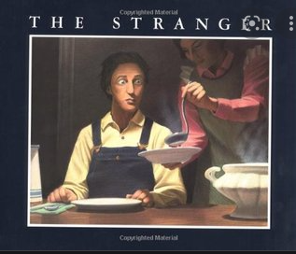
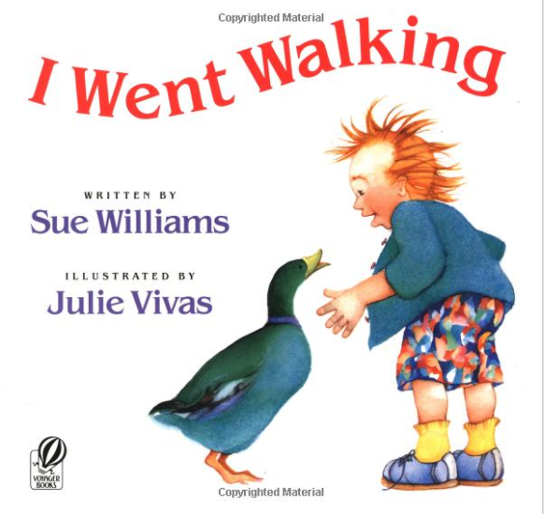

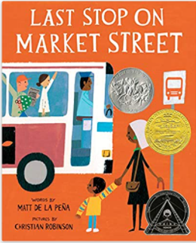
Learners and the Literacy Environment
18
Read, read, read. Books, books, books.

Slide 19
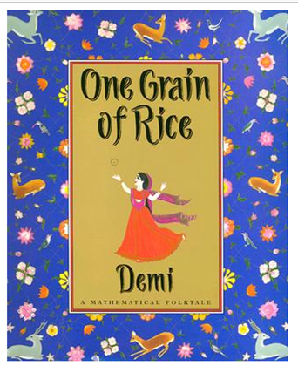
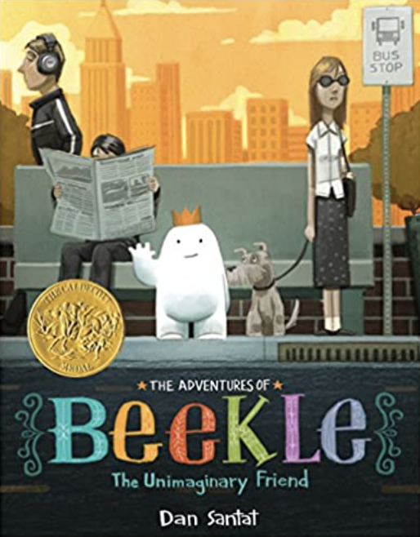

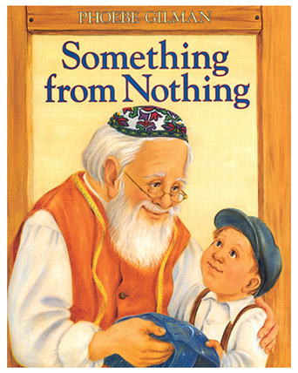
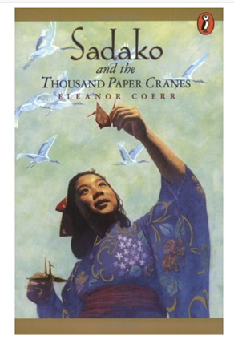
Learners and the Literacy Environment
19

Slide 20
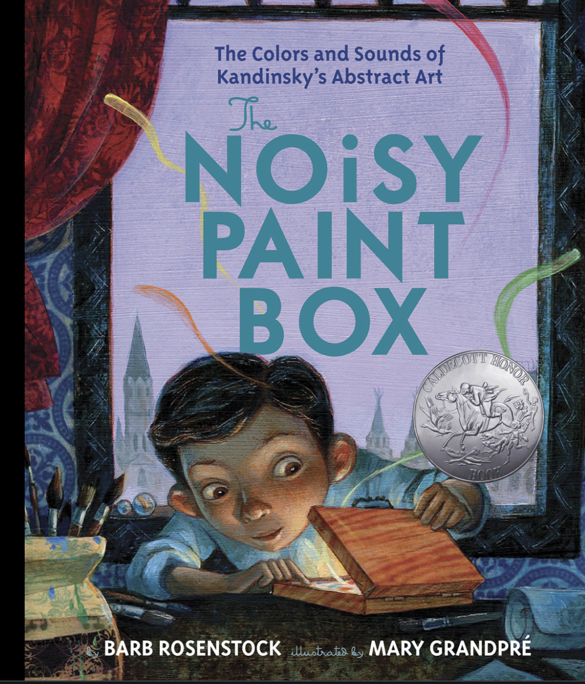

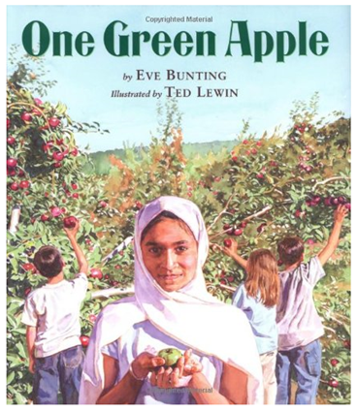
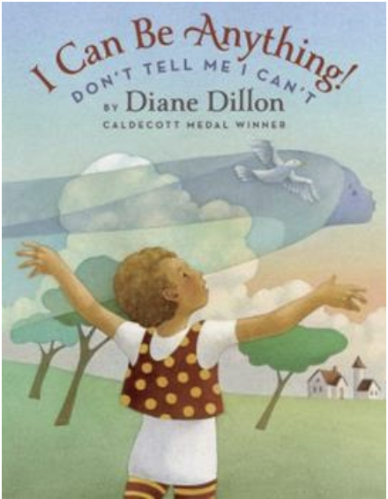

Learners and the Literacy Environment
20

